Slide 1
Chapter 17
Manifest Destiny and Its Legacy, 1841-1848

Slide 2
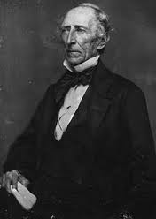
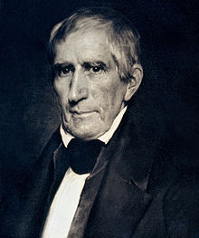
Tippecanoe & “Tyler Too”
Election of 1840: WHH wins, dies 30 days into office
John Tyler becomes President, blocked Webster and Clay’s plans
John Tyler
Former Jacksonian Democrat, switched to the Whigs because he didn’t like Jackson (dictator)
Leads to conflict with Whigs, claiming he was still a Democrat
Against Banks (kills the independent treasury), tariffs, and internal-improvements (Clay’s American System)
“a Democrat in Whig clothing”
His entire cabinet resigns

Slide 3
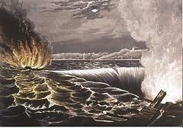
Trouble with Britain
Author’s of British travel books ridiculed America: lynching, slave auctioneering, eye gouging, etc.
1837, Caroline incident:
Legend has it that a British force attacked an American steamer on the Niagara River, set the ship on fire
Creole incident:
130 slaves rebelled and captured the American ship, and Britain offers asylum to the slaves
Fear that Caribbean would be a haven for slaves like Canada

Slide 4
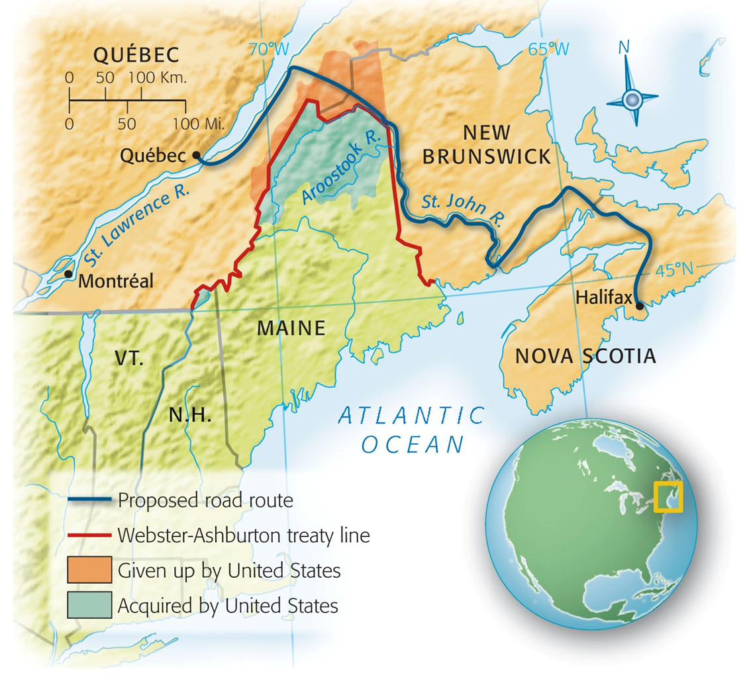
Manipulating the Maine Maps – ParT I of Tyler’s Foreign policy
“Aroostook War”:
Dispute in ME between American and Canadian lumberjacks threatened all-out war
St. Lawrence River is icebound for several months
British wanted a land route from Halifax to Quebec when the river freezes
Webster-Ashburton Treaty (1842)
Americans retained 7,000 square miles of the 12,000 in dispute
British got the Halifax-Quebec route

Slide 5
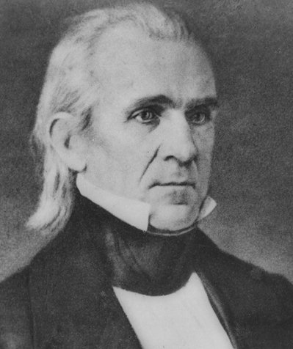
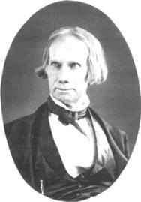
Election of 1844
Election of 1844: James K. Polk (Democrat) vs. Clay (Whig), Polk wins
As a lame duck president, Tyler believed he should acquire Texas (Part 2 of Tyler’s Foreign Policy success)
Texas was annexed by a joint resolution
requires a majority in both houses, NOT a treaty which requires 2/3 approval in the Senate
1845 Texas was invited to be the 28th state

Slide 6
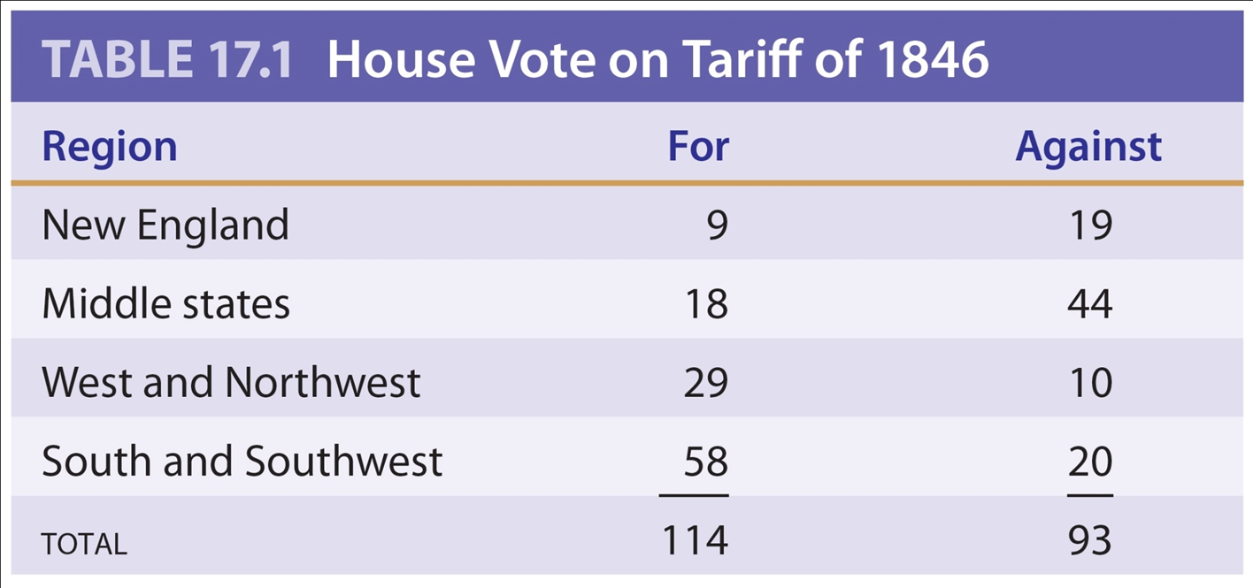
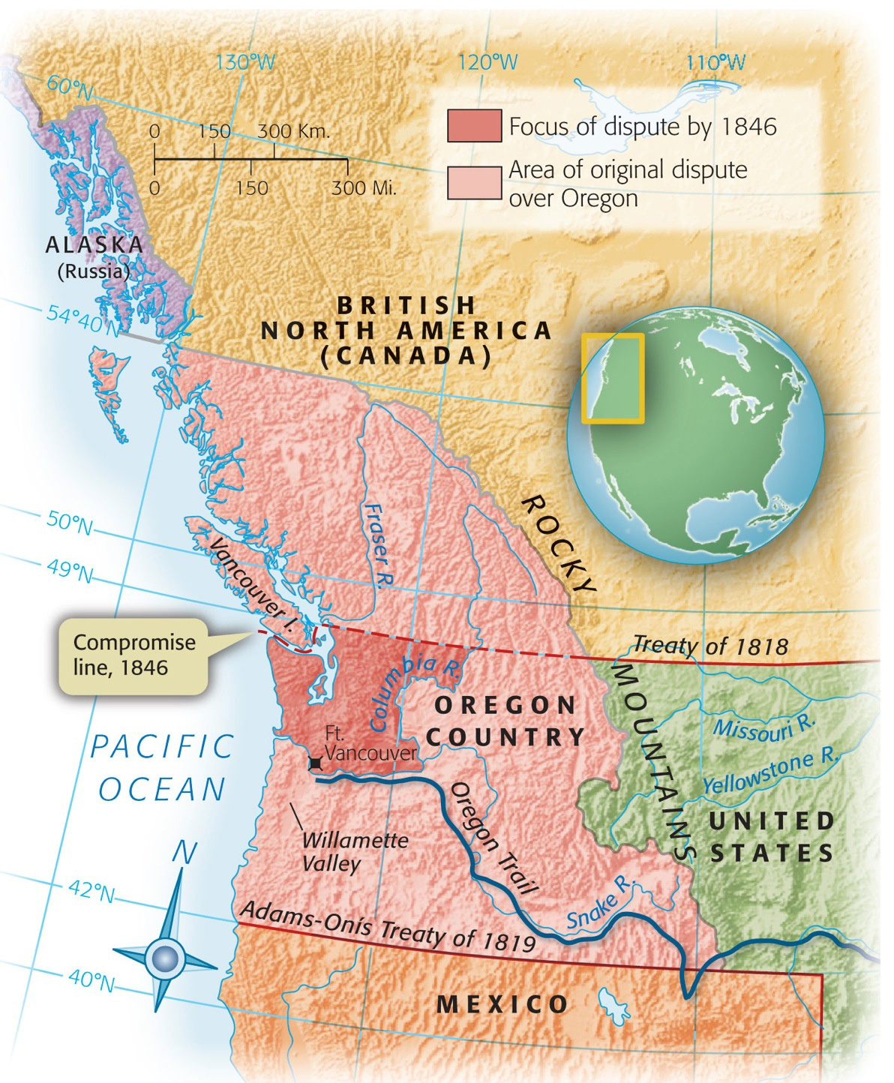
Polk the Purposeful
Polk’s presidency can be summarized as COIL:
California
Oregon
Independent Treasury
Lower tariffs
Reduced tariffs to 25% from 1842’s 32%
Democrats decrease tariffs
Restored the Independent Treasury (killed by Tyler)
Acquired California
Settled Oregon territory dispute (49th parallel)

Slide 7
Misunderstandings with Mexico
Polk wanted to buy CA, but Mexico was reluctant to sell
Mexico still viewed Texas as theirs
Rumors of Britain buying or seizing California scared Americans
US envoy instructed to offer $25 million for California

Slide 8
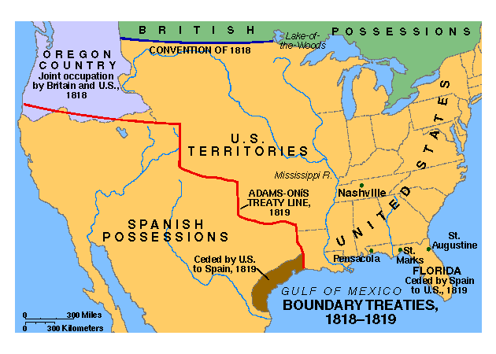
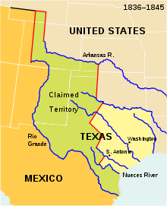
American Blood on American (?) Soil
President Polk orders General Zachary Taylor (future president) to march near Mexico TX boundary in January
What former Presidents were also Generals?
He was planning on asking Congress in May for war
April 25, 1846 Mexican troops attacked Taylor’s troops killing or wounding 16
Polk urges Congress to go to war
Many in Congress, including Lincoln want to know exact spot attack occurred (Spot Resolutions)

Slide 9
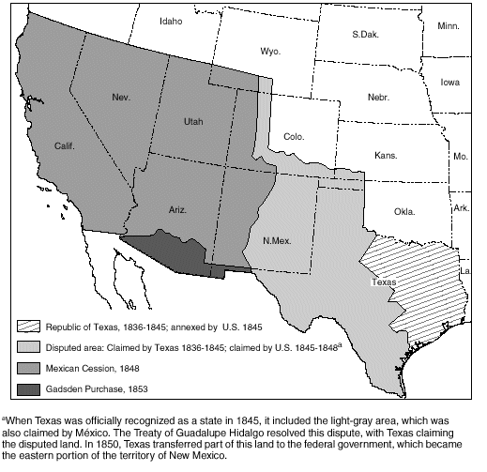
Fighting Mexico for Peace
Nicholas Trist negotiated treaty with Mexico
Treaty of Guadalupe Hidalgo
U.S. gained California, and modern-day NM, AZ, UT and NV -- ½ of Mexican territory
U.S. to pay $15 million
Conscience Whigs (or “Mexican Whigs”) denounced the war for its possible expansion of slavery
John C. Calhoun (southerner) – “South would do well not to be too greedy”

Slide 10
Wilmot Proviso (So important it gets its own slide)
David Wilmot, representative from PA was afraid of slavery expanding
Introduced an amendment that stipulated that “slavery should never exist in any form of the territory to be wrestled from Mexico”
Wilmot Proviso never becomes federal law, but endorsed by most free states
Ideas later adopted by Free-Soil Party

